Slide 1

I Stand With You: Using Emojis to Study Solidarity in Crisis Events
Sashank Santhanam, Vidhushini Srinivasan,
Shaina Glass & Samira Shaikh
UNC Charlotte
Emoji-2018 Workshop at ICWSM
June 25th, 2018

Slide 2
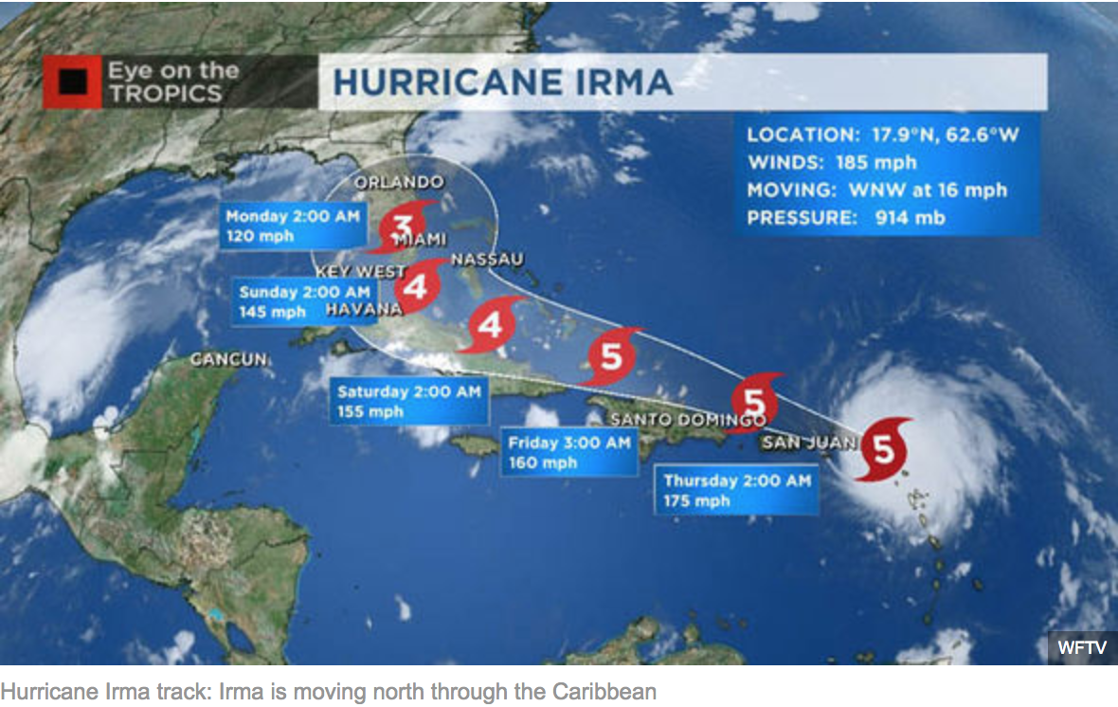
Crisis Event - Hurricane Irma (Sept 2017)
Notes:
Take place across time
Take place across geographical regions

Slide 3
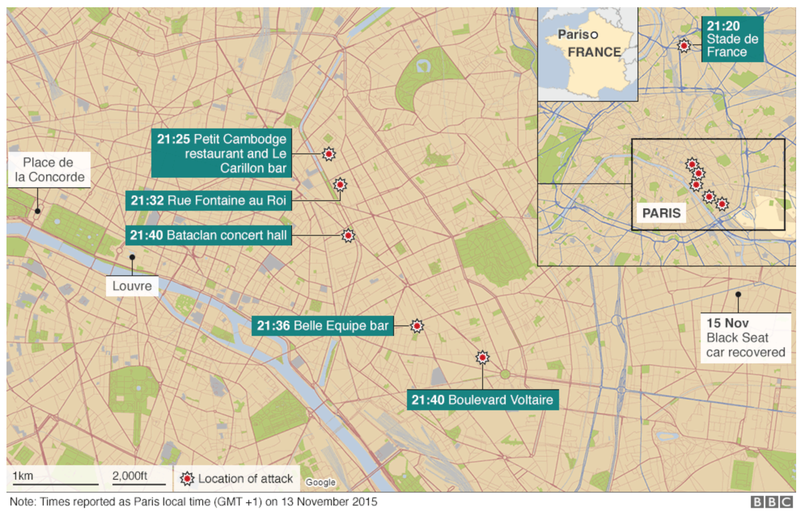
Crisis Event - Paris Terrorist Attacks (Nov 2015)

Slide 4
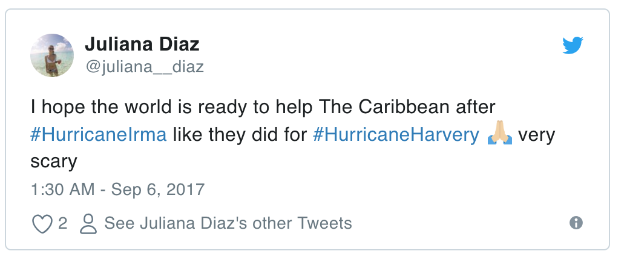
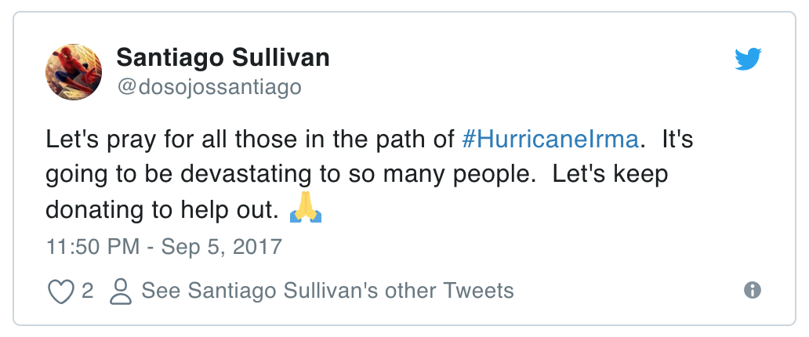
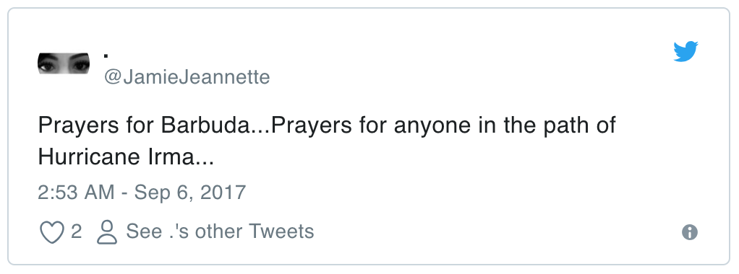
How social media responded to crisis events?
Notes:
People are expressing solidarity and emojis are used with it

Slide 5
How social media responded to crisis events?
Notes:
Point out santiago

Slide 6
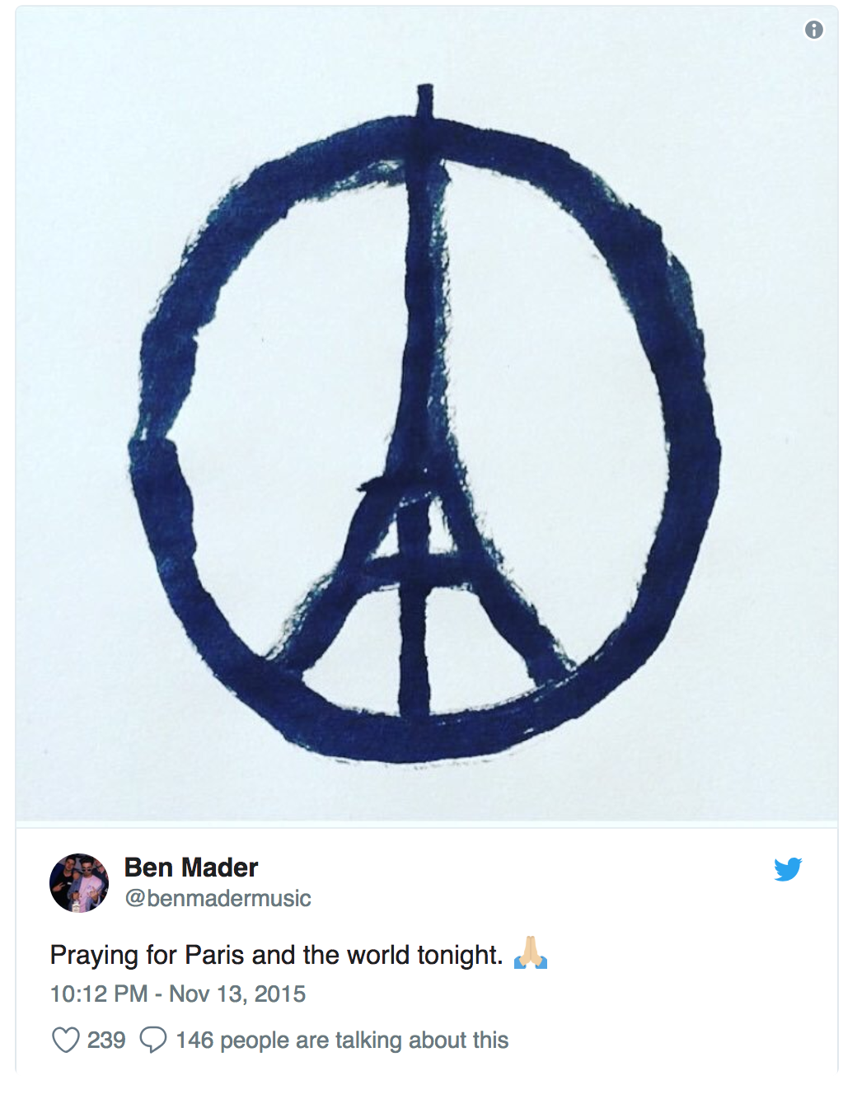
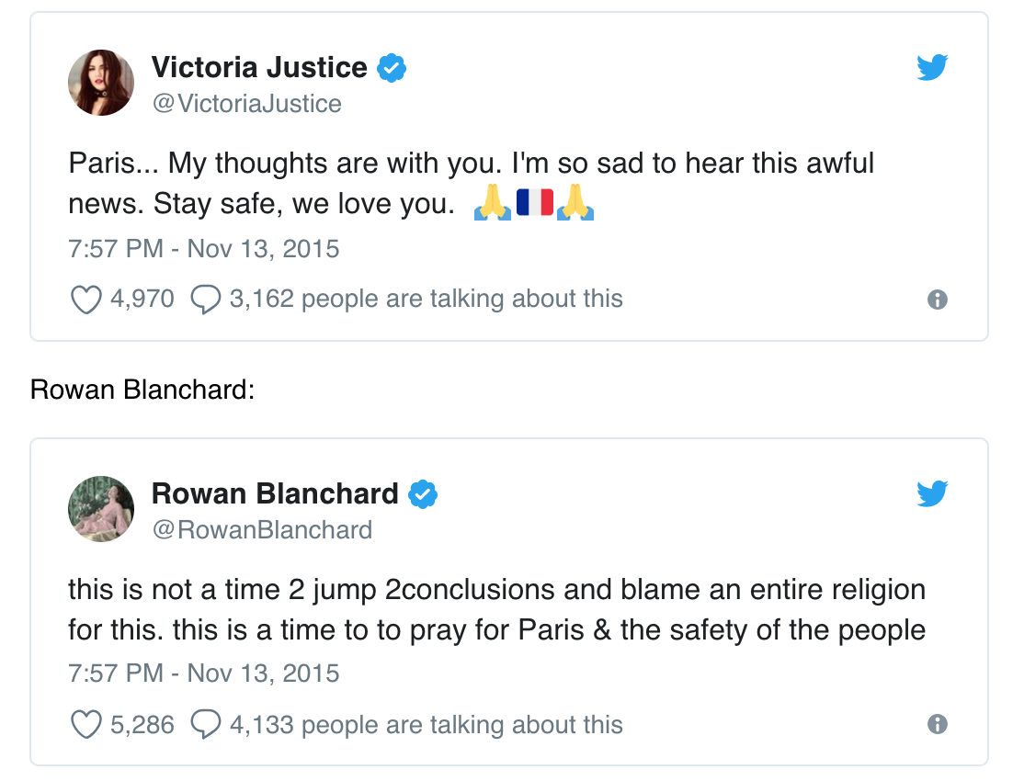
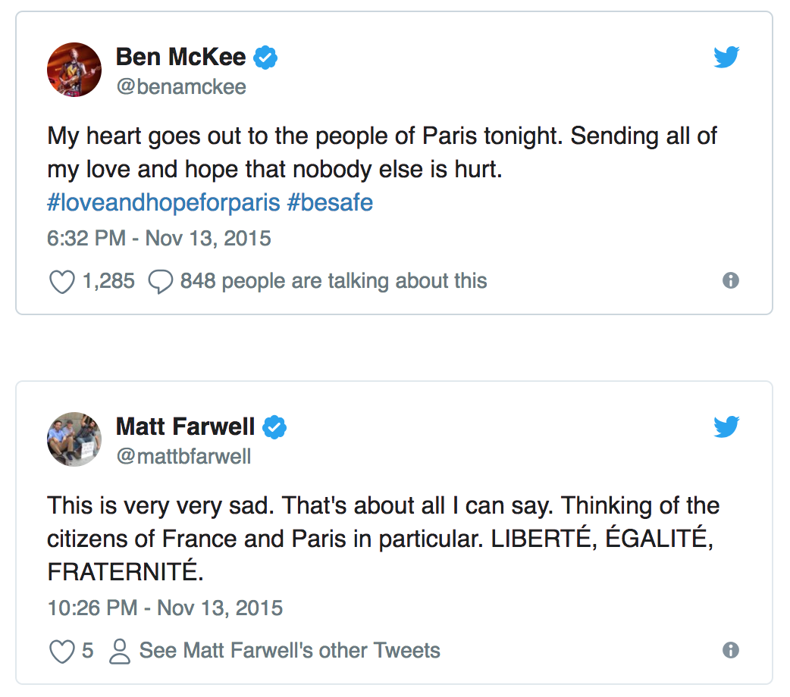
How social media responded to crisis events?
Notes:
The statement “I support you” is obvious by the author of the post, but it’s too granular in terms of identity. “We support you” is more powerful, as “we” is bigger than “I”... Thus, SM users tend to use the most identity-rich “We” they can find,

Slide 7
How social media responded to crisis events?
Notes:
French flag and hashtags

Slide 8
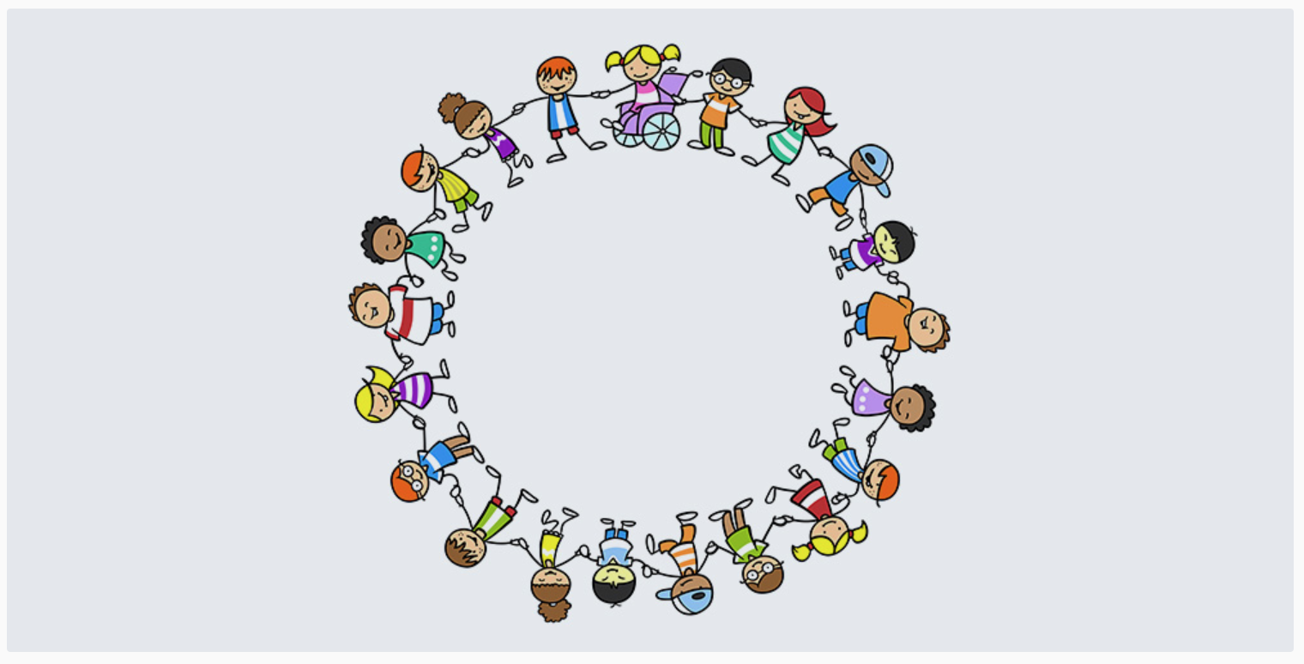
Solidarity: community spirit or mutual attachment, social cooperation or charity
(Kurt Bayertz, 1999)
Expressional solidarity: Individuals expressing empathy and support for a group they are not directly involved in
(Ashley E Taylor, 2015)

Slide 9
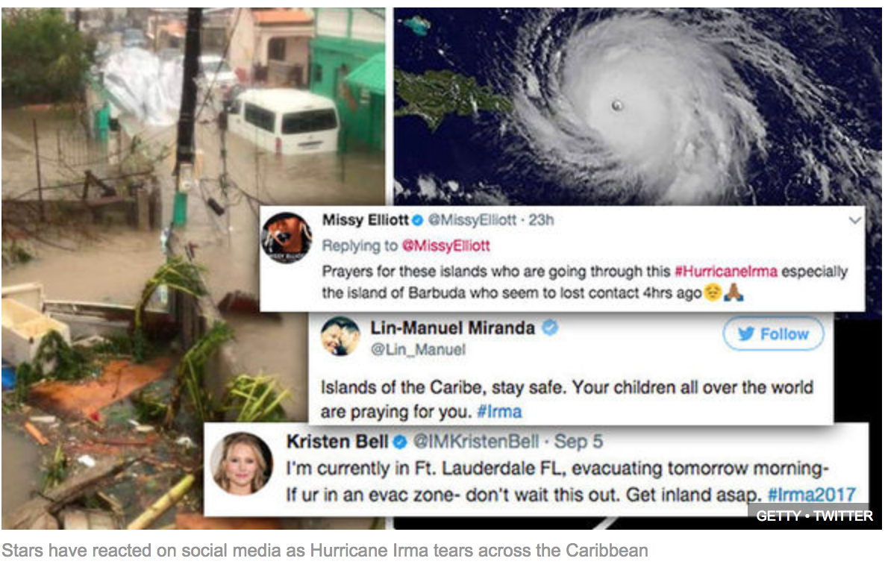
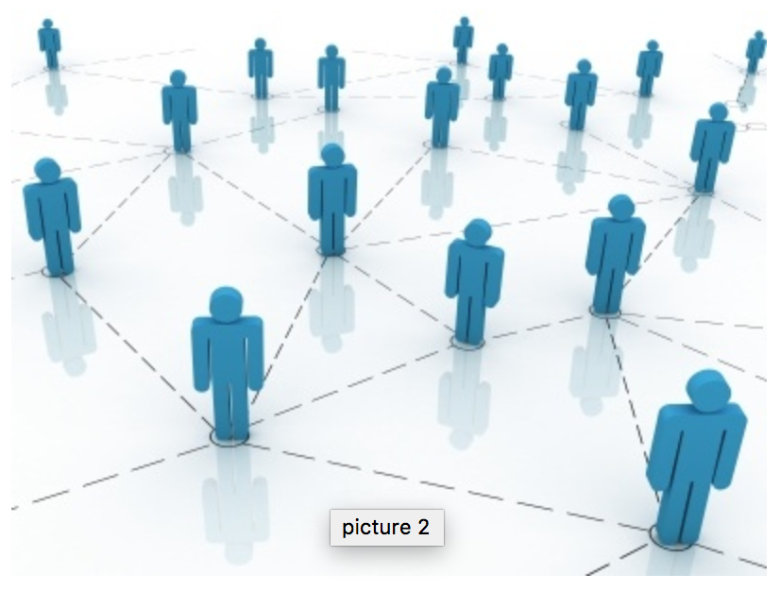
Why study Solidarity on social media?
Understanding collective social movements and prosocial behaviors in online social networks, for example #BlackLivesMatter, #NeverAgain, #MeToo
Notes:
Everybody behaves very homogeneously with- in their own community, following recurrent communication patterns. But when a tragic event shakes people’s minds, they feel the impulse to break these patterns and communicate their feelings to a bigger audience.
there are certain circumstances where an event triggers a quite unexpected reaction, where surprisingly many users join forces to participate in a bigger scale dialogue, interacting with anonymous users around the world to adhere to the same message, motivated by the need to speak up and the need to share feelings and to show support to other users in the same circumstance.
When such a tragic event occurs, it’s not about differences... Rather, SM users seek for unity and sense of community. Users that usually don’t post in any other language but theirs, adopt foreign languages hashtags related to the event in their communication.
Online behaviors leads to offline behaviors - like donating, participating in offline movements in terms of BLM or even Never again

Slide 10
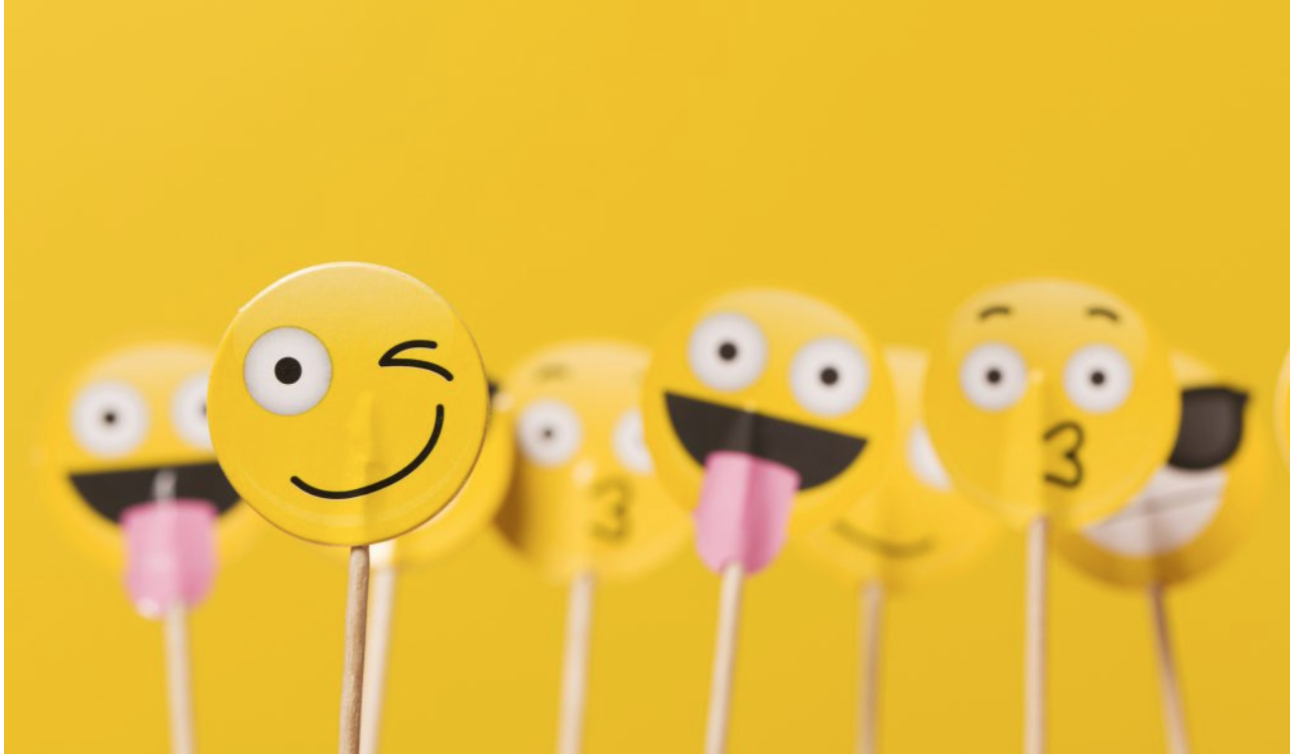
Why are Emojis important?
Easy to be misunderstood but important when communicating online
When used with text, emojis can reinforce the message
(Markman & Oshima, 2017).
Emojis more likely to be used
in socioemotional
contexts like crisis events
(Derks et al, 2007).

Slide 11
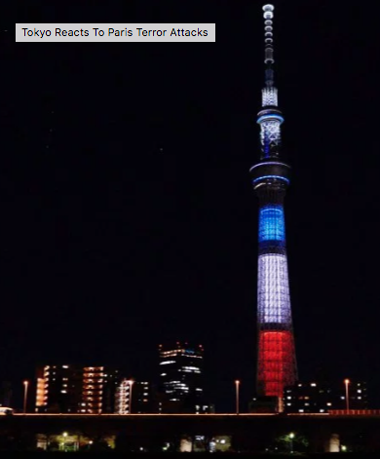
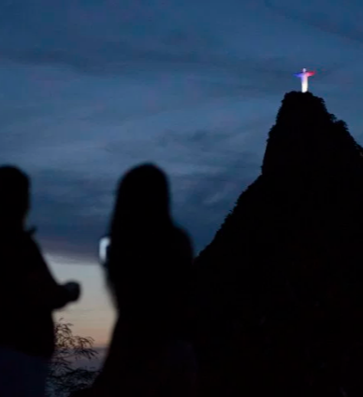
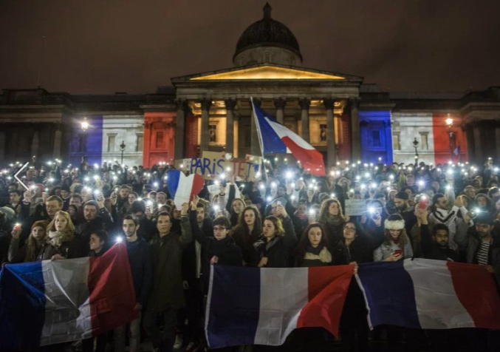
Our Hypotheses
H1: Emoji play a role in automatically identifying (and reinforcing) solidarity messages.
H2: Solidarity is expressed differently by people affected by the crisis event vs. those who are not affected and also over time through their use of emojis.

Slide 12
Data and Pre-processing
Hurricane Irma: 16MM tweets between Sept 6th-12th, 2017.

Slide 13
Data and Pre-processing
Hurricane Irma: 16MM tweets between Sept 6th-12th, 2017.
Paris Attacks: 2MM tweets between Nov 13th-Nov 17th, 2015.

Slide 14
Data and Pre-processing
Hurricane Irma: 16MM tweets between Sept 6th-12th, 2017.
Paris Attacks: 2MM tweets between Nov 13th-Nov 17th, 2015.
Performed Distance Labeling of hashtags (𝜅 = 0.65 )
Solidarity - #solidaritywithparis, #prayersforpuertorico
Not Solidarity - #breakingnews, #facebook

Slide 15
Data
# of Tweets | Solidarity | Not Solidarity | Total
Irma | 12000 | 81697 | 93697
Paris | 20465 | 29874 | 50339

Slide 16
RQ1: How useful are emojis as features in classifying expressions of solidarity?

Slide 17
Accuracy | Irma corpus | Paris corpus
RNN + LSTM (with emojis) | 93.5% | 86.7%
RNN + LSTM (without emojis) | 89.8% | 86.1%
TF-IDF | 85.71% | 75.72%
TF-IDF + Bigrams | 82.62% | 76.98%
Bigrams only | 79.86% | 75.24%

Slide 18
RQ2: Which emojis are used in expressions of solidarity of crisis events and how do they compare to the emojis used in other (regular) tweets?

Slide 19
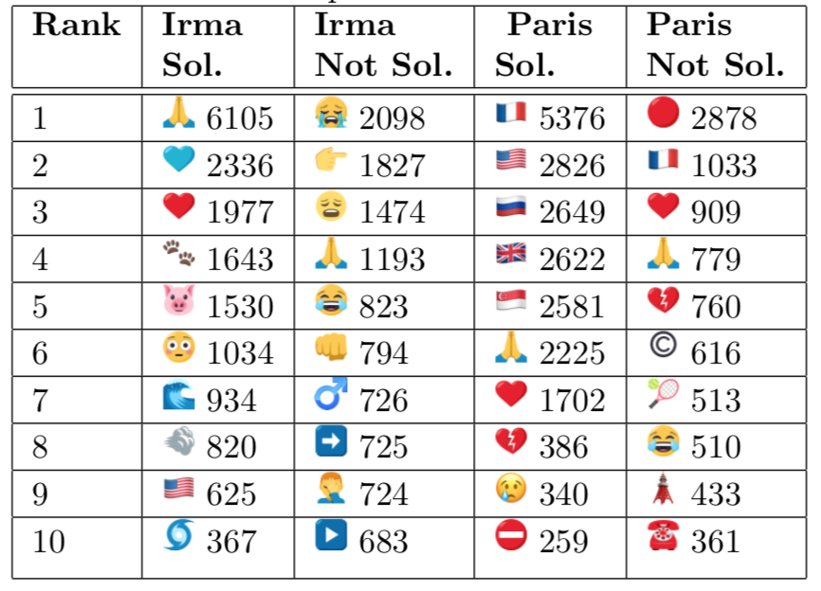
Notes:
Total - 52101, roughly 50% on solidarity and 50 % form non solidarity
Paris - 37104 - 75% in solidarity and 25% from non solidarity
Focus only on the heart symbol and not in not solidarity ones - Irma
Paris - focus on flags

Slide 20
Notes:
Total - 52101, roughly 50% on solidarity and 50 % form non solidarity
Paris - 37104 - 75% in solidarity and 25% from non solidairty
Flags can be used to express how solidarity is expressed

Slide 21
RQ3: Which emojis co-occur in tweets that are posted within areas directly affected by crisis events as compared to those tweets that are posted from other areas?

Slide 22
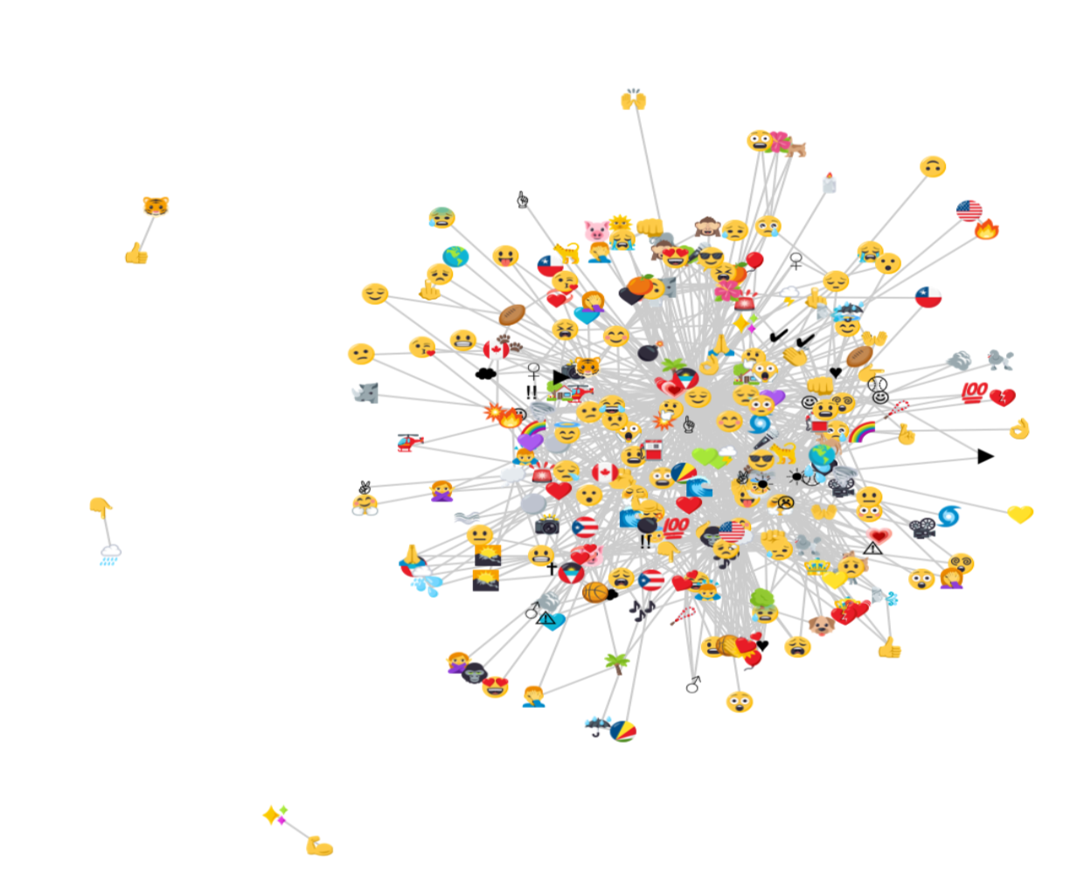
Irma within affected regions
Notes:
Collision emoji center of affected and not at the center of the affected.
Sadness is the center of the emojis for regions outside irma.

Slide 23
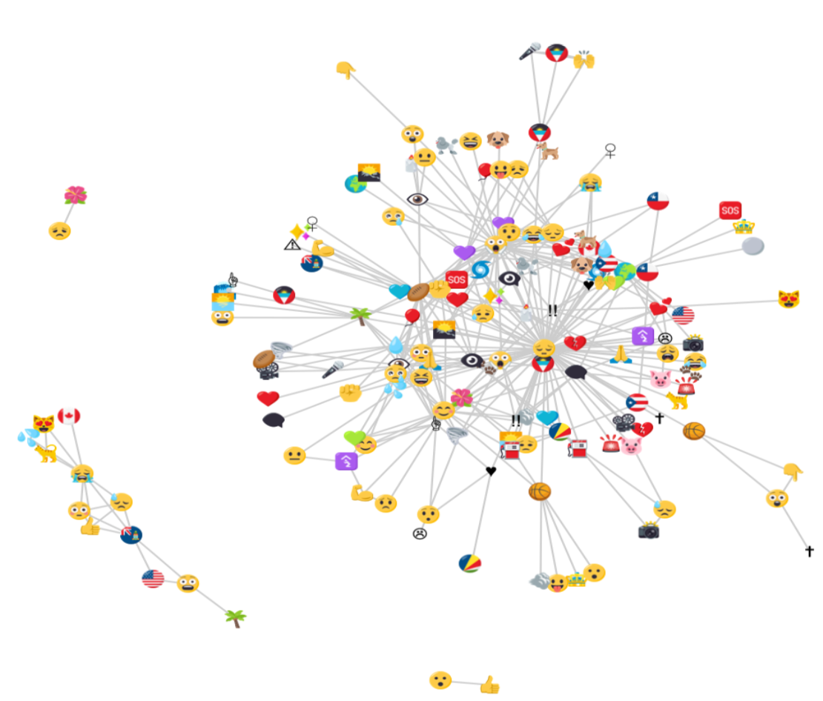
Irma within affected regions
Irma outside affected regions
Notes:
Collision emoji center of affected and not at the center of the affected.
Sadness is the center of the emojis for regions outside irma.

Slide 24
Irma within affected regions
Irma outside affected regions
Notes:
Collision emoji center of affected and not at the center of the affected.
Sadness is the center of the emojis for regions outside irma.

Slide 25
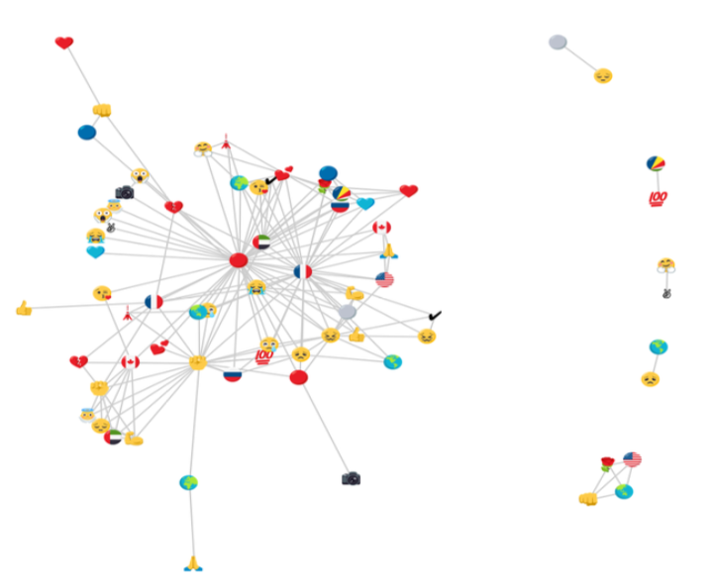
Paris within affected regions

Slide 26
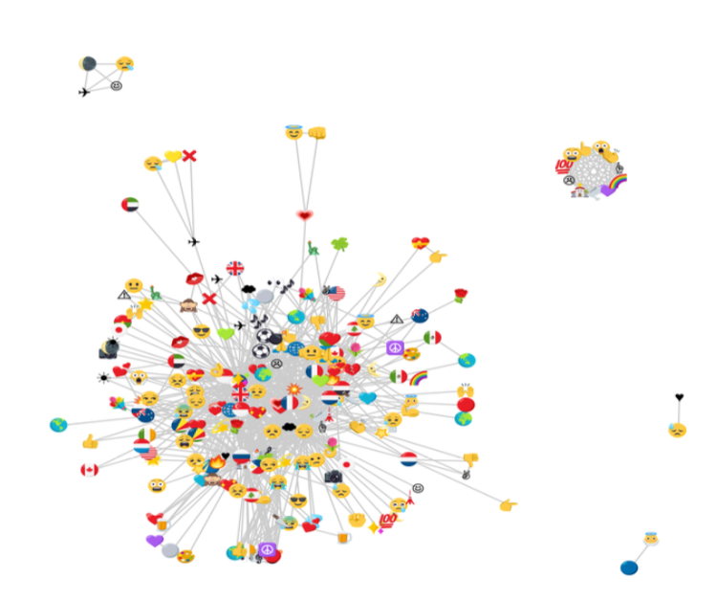
Paris within affected regions
Paris outside affected regions

Slide 27
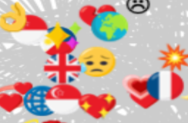
Paris within affected regions
Paris outside affected regions

Slide 28
RQ4: How can emojis be used to understand the diffusion of solidarity expressions over time?

Slide 29
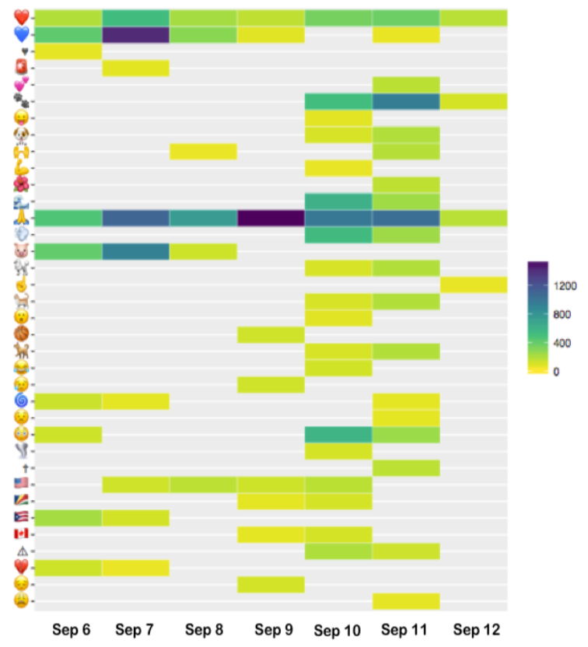
Irma solidarity
Sentiment
Notes:
We are trying to understand, find different patterns of how people express shock, broken heart and alerts
Broken heart appears and never appears
Alert symbol appears later but not in the early stages
Shock emoji

Slide 30
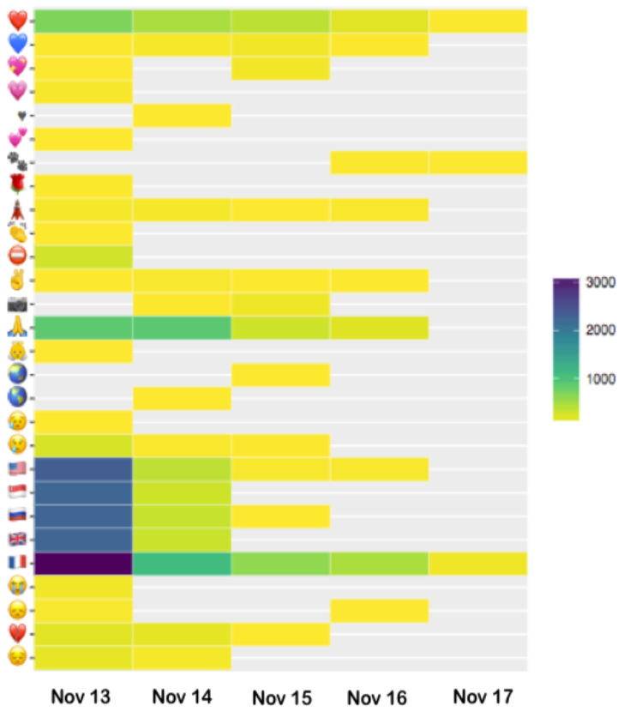
Paris solidarity
Sentiment
Notes:
Focus on mainly the flags,

Slide 31
RQ5: How can emojis be used to study the temporal and geographical diffusion of solidarity expressions during crisis events?

Slide 32
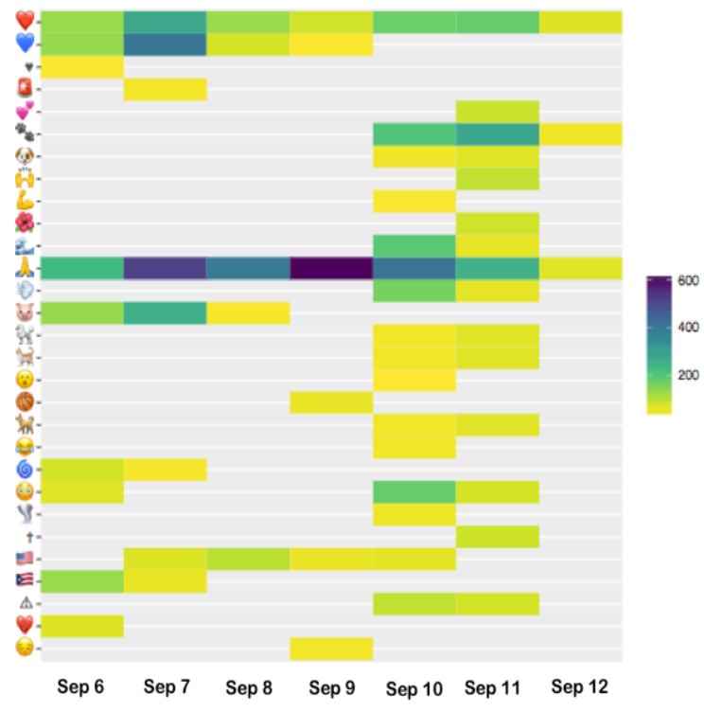
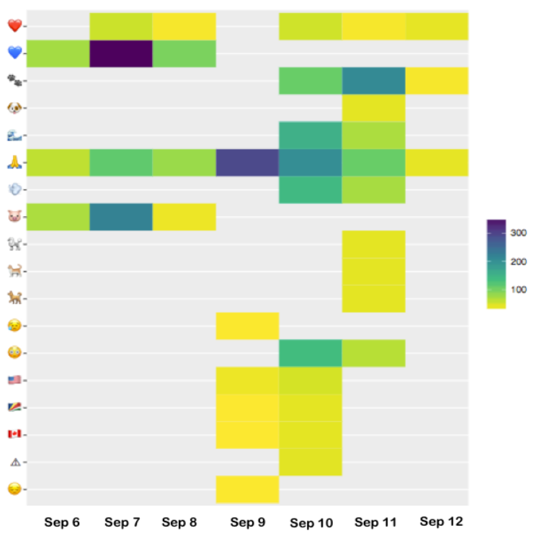
Irma within affected regions
Irma outside affected regions
Sentiment

Slide 33
Take Home Message
Emojis offer a crucial window into human behavior
Notes:
We show how emojis offer a crucial behavior through time and geographical regions.

Slide 34
Take Home Message
Emojis offer a crucial window into human behavior and how it evolves over time and geographical region

Slide 35
Take Home Message
Emojis offer a crucial window into human behavior and how it evolves over time and geographical region especially in the context of crisis events

Slide 36
Take Home Message
Emojis offer a crucial window into human behavior and how it evolves over time and geographical region especially in the context of crisis events and collective social movements.
We show this with the specific behavior of solidarity in two specific crisis contexts.

Slide 37


Email: ssantha1@uncc.edu
Github: http://github.com/sashank06 ← Dataset available publicly

Slide 38
References
Paris Attacks timeline - https://www.bbc.com/news/world-europe-34818994
Irma timeline - https://www.express.co.uk/news/weather/850567/Hurricane-Irma-track-florida-usa-path-map-forecast-when-were
https://www.nytimes.com/2015/11/15/technology/as-paris-terror-attacks-unfolded-social-media-tools-offered-help-in-crisis.html
https://www.bustle.com/p/31-hurricane-irma-tweets-that-emphasize-the-storms-intensity-as-it-makes-landfall-81152
https://variety.com/2015/digital/news/paris-attacks-celebrities-react-1201640343/
https://ec.europa.eu/education/news/20170523-increase-solidarity-in-schools_en
https://www.oxfordstudent.com/2015/11/25/we-need-to-look-beyond-social-media-for-solidarity/
https://www.boomlive.in/the-streets-of-paris-are-as-familiar-to-me-as-the-streets-of-beirut/

Slide 39
More References
7. https://www.boomlive.in/the-streets-of-paris-are-as-familiar-to-me-as-the-streets-of-beirut/
8.https://www.oxfordstudent.com/2015/11/25/we-need-to-look-beyond-social-media-for-solidarity/
9.https://www.psychologytoday.com/us/blog/contemporary-psychoanalysis-in-action/201605/why-do-we-use-emojis
10. http://451heat.com/2017/11/13/the-newest-emojis-what-that-means-for-social/
11. http://time.com/4112947/paris-attacks-world-photos/

